Slide 1
The New Updated and Deleted Records in the General Publishing Profile
Yoel Kortick
Senior Librarian

Slide 2

Agenda
Introduction
The set we will use
The Publishing Profile
The New Updated and Deleted Record Examples
The Publishing of the New Updated and Deleted Records

Slide 3
Introduction
The purpose of this presentation is to specifically show how new, updated and deleted records are handled via the General Publishing Profile in Alma.
This is not a presentation on the entire overall functionality of the general Publishing Profile.
It specifically relates to how the new, updated and deleted records are published.
For a general overview of the General Publishing Profile see Publishing and Inventory Enrichment (General Publishing)

Slide 4
The set we will use

Slide 5
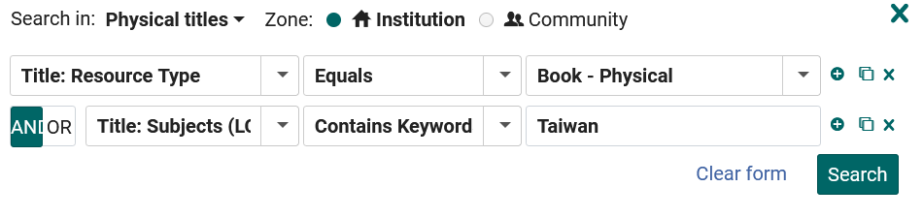
The set we will use
We have a logical set of 32 records.
The set is called "Physical Titles Subject LC Taiwan Resource Type Book Physical".
It contains, as the title suggests, physical titles which meet this criteria:

Slide 6
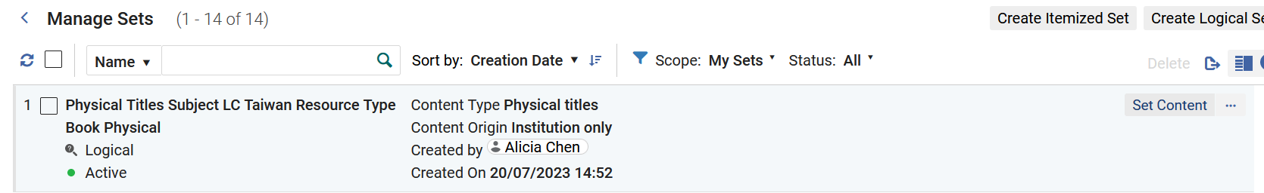
The set we will use
Let’s look at the contents of the set

Slide 7
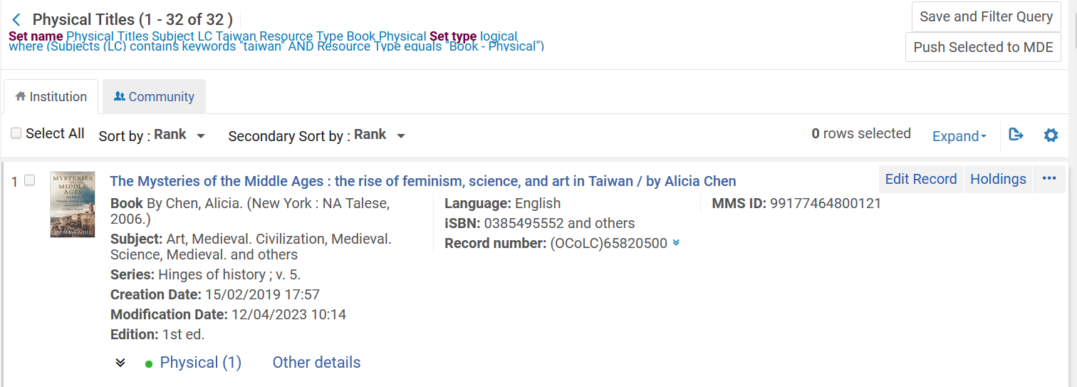
The set we will use
It has 32 records

Slide 8
The Publishing Profile

Slide 9
The Publishing Profile
The publishing profile which we will use here uses the set we previously saw called "Physical Titles Subject LC Taiwan Resource Type Book Physical"
It exports in format MARC XML
We are exporting to MARC XML because this will allow us (as we will soon see) to take note of how the deleted record is published. We will be able to look at specific fields without needing to first convert a MARC Binary file.
The General Publishing Profile we will use here is called "Subject Taiwan Physical Resources Book"

Slide 10
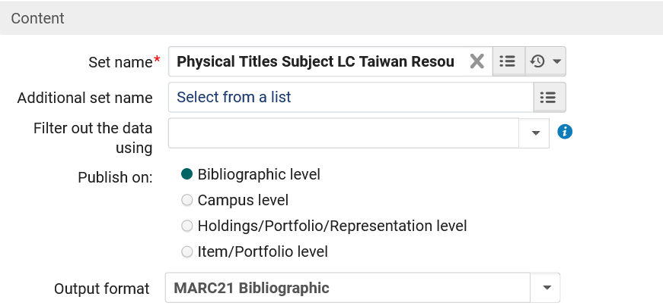
The Publishing Profile
Here is the "Content" section
The set we saw earlier
Publishing to MARC21

Slide 11
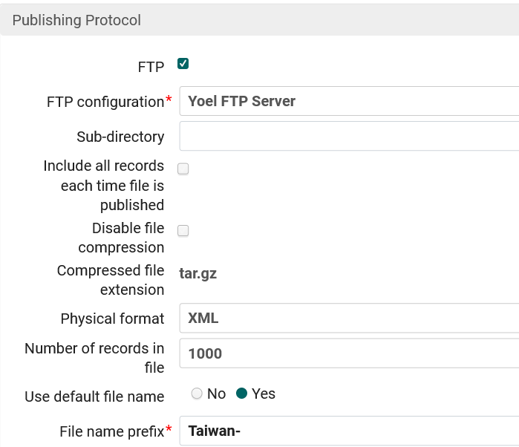
The Publishing Profile
Here is the "Publishing Protocol" section
Publishing to FTP server
We are not including all records each time the publishing job runs (this means that after the first run only New, Updated and Deleted records will be published)
Publishing in XML

Slide 12
The Publishing Profile
The job has run the first time, and all 32 records are published

Slide 13
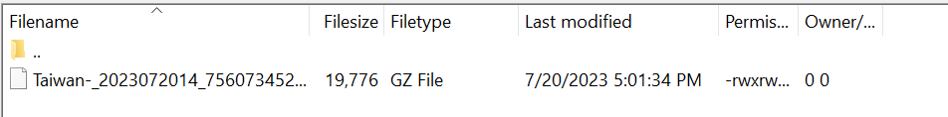
The Publishing Profile
Here is the file of all 32 records on the ftp server:

Slide 14
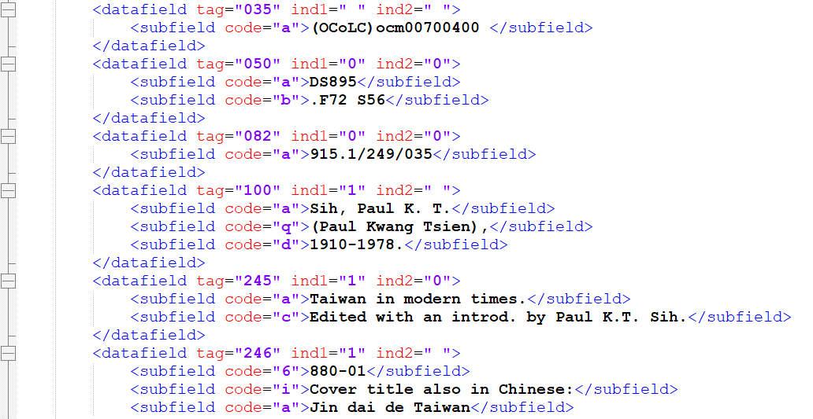
The Publishing Profile
Here is part of the file

Slide 15
The New Updated and Deleted Record Examples

Slide 16
The New Updated and Deleted Record Examples
Now we will
Add a new record to the repository which meets the criteria of the logical set and thus the record will be added to the logical set
Delete a record in the logical set.
Edit (modify) an existing record in the logical set.

Slide 17
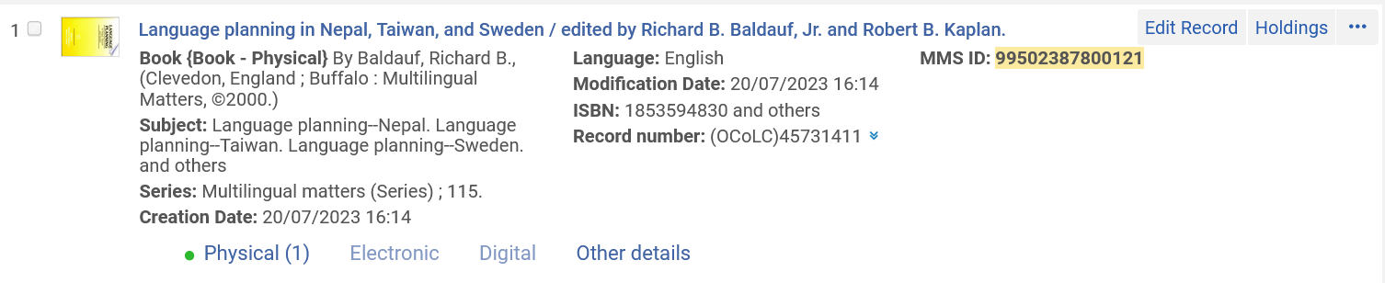
The New Updated and Deleted Record Examples
We added new title "Language planning in Nepal, Taiwan, and Sweden" (MMSID 99502387800121).

Slide 18
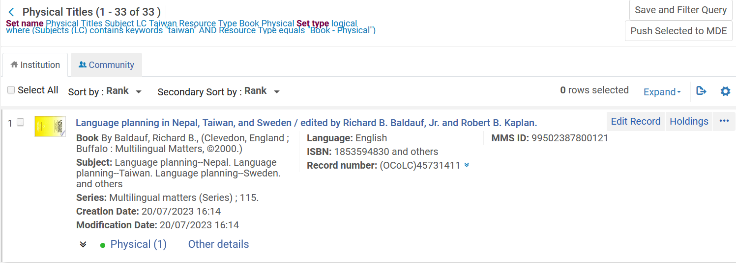
The New Updated and Deleted Record Examples
The new title is in the logical set

Slide 19
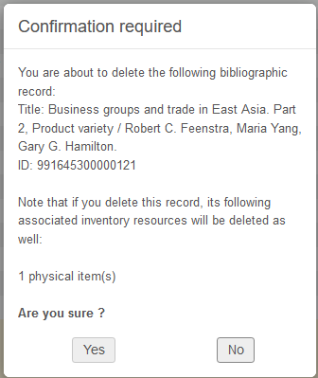
The New Updated and Deleted Record Examples
We will delete title "Business groups and trade in East Asia. Part 2, Product variety" (MMSID 991645300000121), which is also part of the set

Slide 20
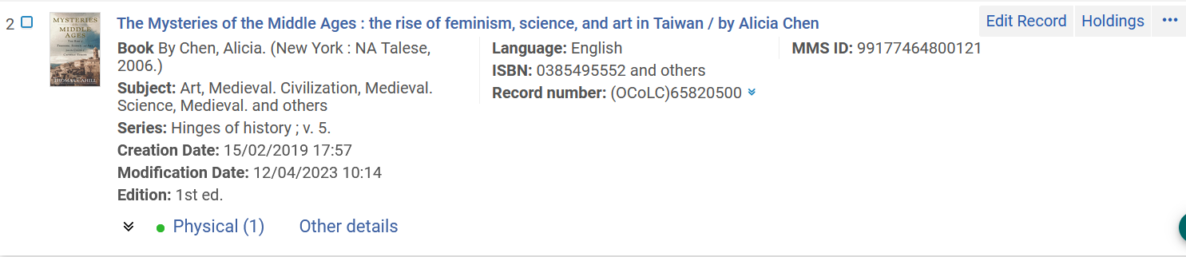
The New Updated and Deleted Record Examples
Now we will edit (modify) title "The Mysteries of the Middle Ages : the rise of feminism, science, and art in Taiwan" (MMSID 99177464800121)

Slide 21
The New Updated and Deleted Record Examples
In sum:
  We added (created new) MMSID 99502387800121 "Language planning in Nepal, Taiwan, and Sweden "
  We deleted MMSID 991645300000121 "Business groups and trade in East Asia. Part 2, Product variety"
  We edited (modified) MMSID 99177464800121 "The Mysteries of the Middle Ages : the rise of feminism, science, and art in Taiwan"

Slide 22
The Publishing of the New Updated and Deleted Records

Slide 23
The Publishing of the New Updated and Deleted Records
The publishing job has run again, and it published the three records (the added, deleted, and edited records)

Slide 24
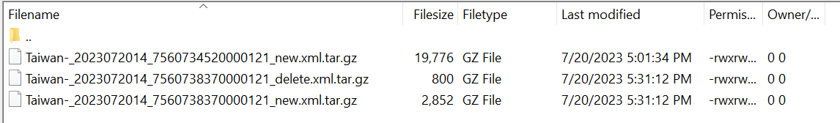
The Publishing of the New Updated and Deleted Records
Let’s see the newly published three records
This is the file from the first publishing
This is the file of deleted record(s). Note that it states "delete" as part of the name
This is the file of new and edited (modified) records

Slide 25
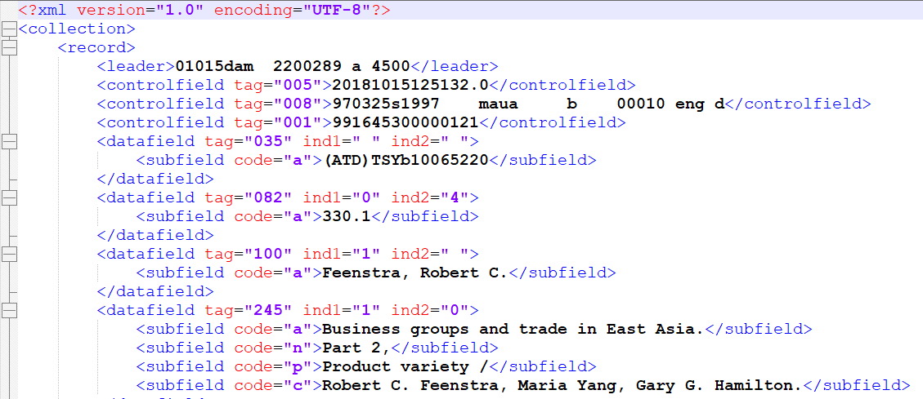
The Publishing of the New Updated and Deleted Records
This is file "Taiwan-_2023072014_7560738370000121_delete"
1. We know this record was deleted because it has a "d" in pos. 5 of the LDR
2. We know this record was deleted because it is in the file with name "delete"

Slide 26
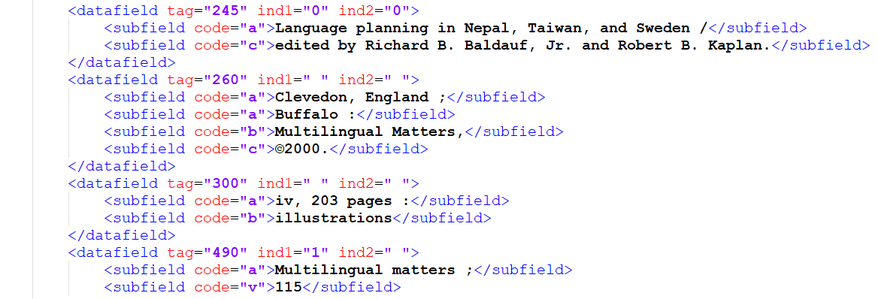
The Publishing of the New Updated and Deleted Records
This is part of file Taiwan-_2023072014_7560738370000121_new
This is the record we added to the repository that fit the criteria of the logical set

Slide 27
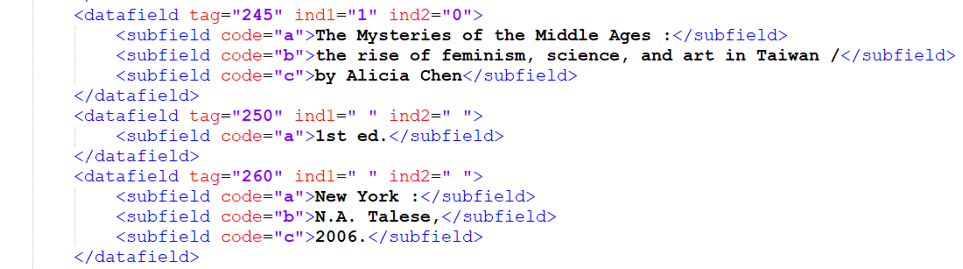
The Publishing of the New Updated and Deleted Records
This is part of file Taiwan-_2023072014_7560738370000121_new
This is the record that was already in the set and already published and we edited (modified) it

